Slide 1
ONLINE TRIP CARS FOR HIRE
OUR GUIDE-MR. SONTHOSH SAHA
OUR TEAM MEMBERS ARE-
SIKHA KUJUR
ANAMIKA DAS

Slide 2
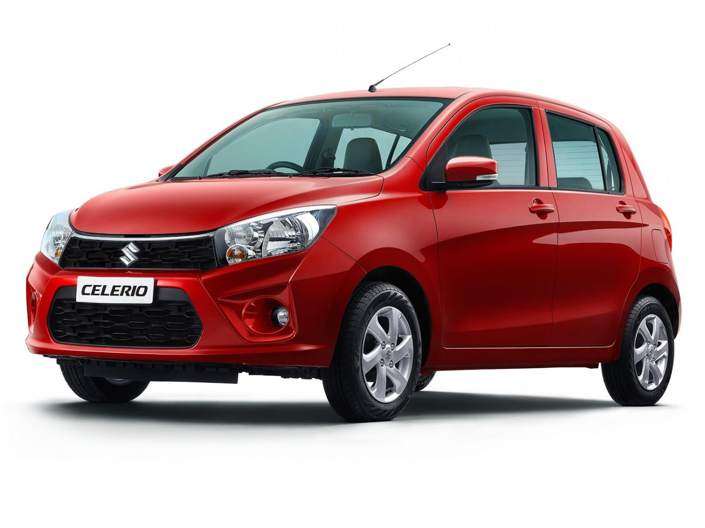
INTRODUCTION
This project is designed so as to be used by Car Rental Company specializing in renting cars to customers. It is an online system through which view available cars, register, view profile and book car.

Slide 3
OBJECTIVES
This online car rental solution is fully functional and flexible.
2. It is very easy to use.
3. This online car rental system helps in back office administration by streamlining and standardizing the procedures.
4.It saves a lot of time, money and labor
5. Eco-friendly: The monitoring of the vehicle activity and the overall business becomes easy and includes the least of paper work.
6. The software acts as an office that is open 24/7.
7. It increases the efficiency of the management at offering quality services to the customers.
8. It provides custom features development and support with the software.

Slide 4
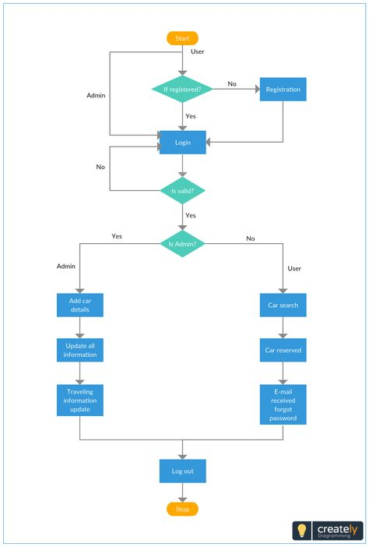
FLOW CHAT

Slide 5
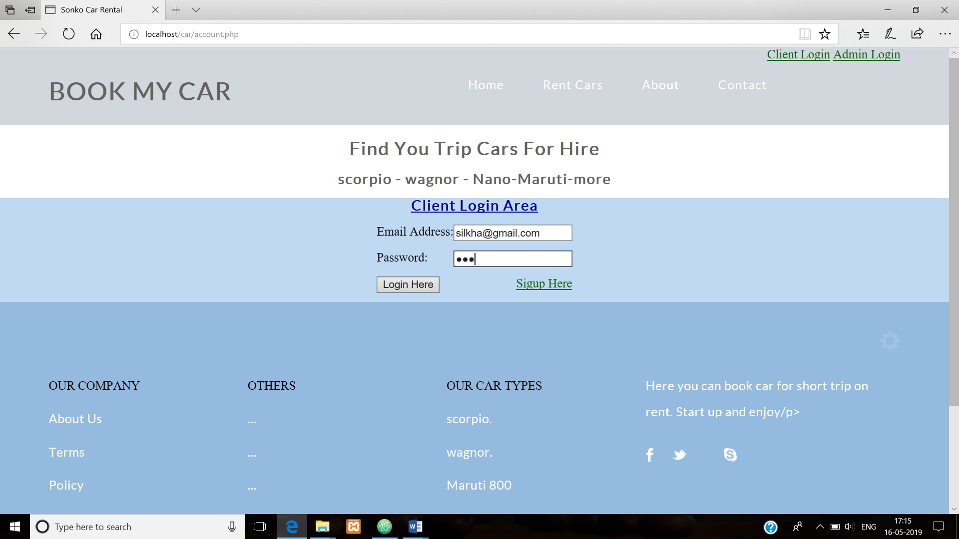
DATABASE
USER

Slide 6
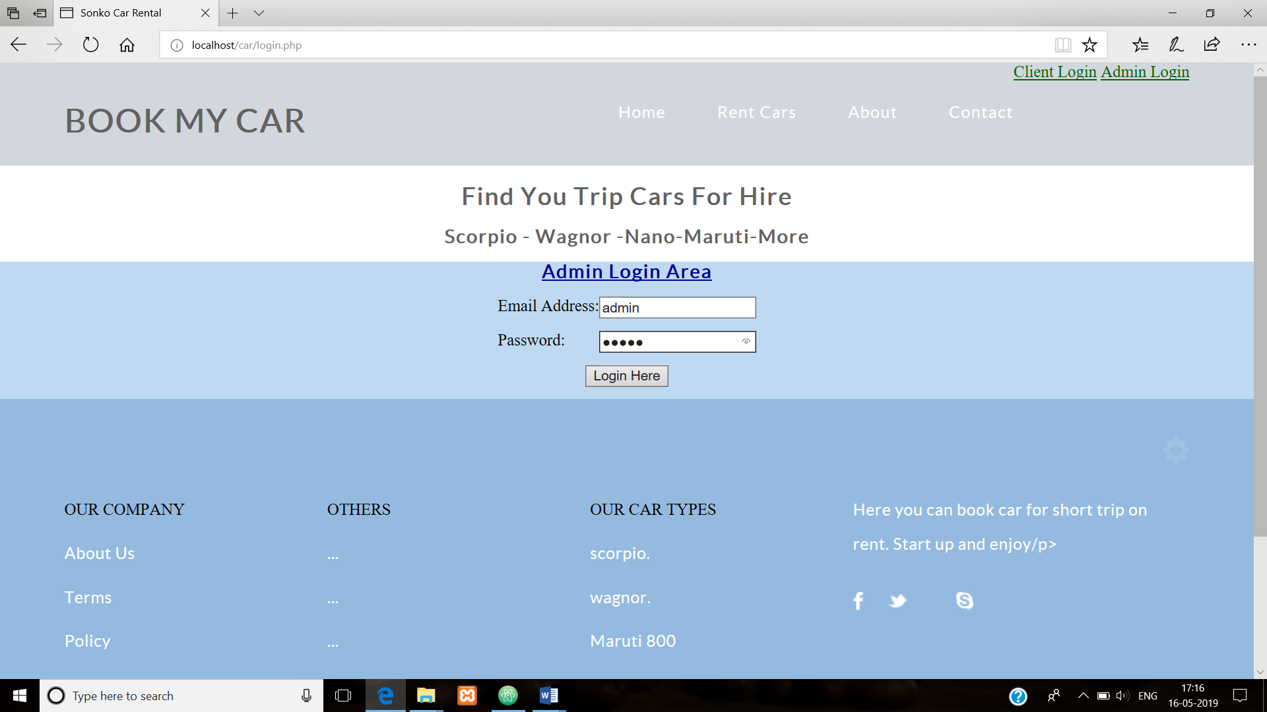
DATABASE
ADMIN

Slide 7
FUTURE SCOPES
This project traverses a lot of areas ranging from business concept to computing field, and required to perform several researches to be able to achieve the project objectives. The area covers include. Car rental industry.
This includes study on how the car rental business is being done, process involved and opportunity that exist for improvement.
PHP Technology used for the development of the application.

Slide 8
CONCLUSION
Enterprise is not really a car rental business at all-it is a customer service business.
Enterprise will continue to develop new market segments and continue to expand internationally, taking advantage of its brand image to identify with new customers in new markets.
The customer relationships Enterprise has built, will only serve to propel Enterprise’s efforts to expand into new market segments.

Slide 9
THANK YOU

